Slide 1


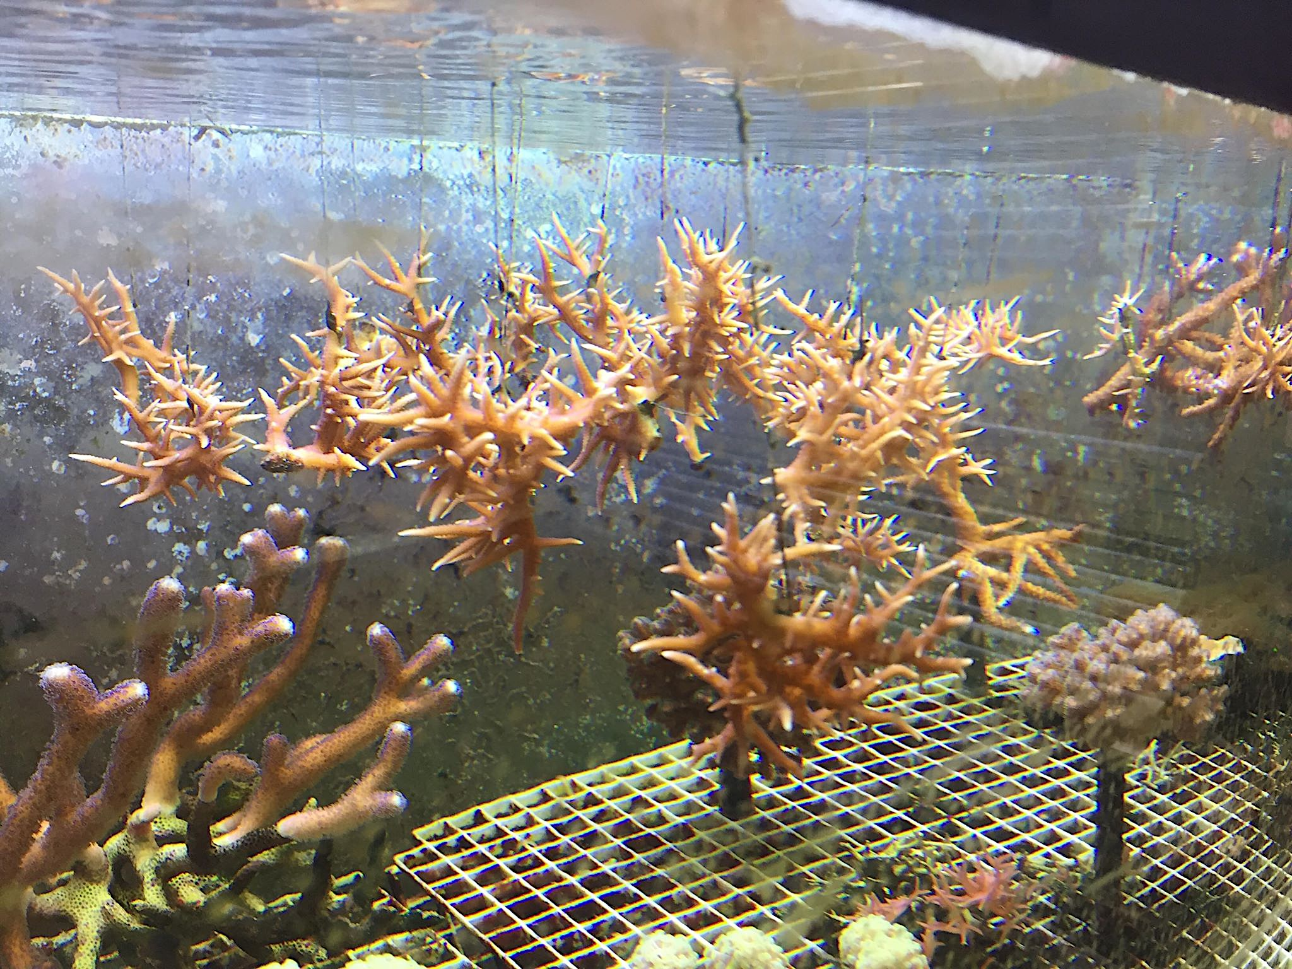
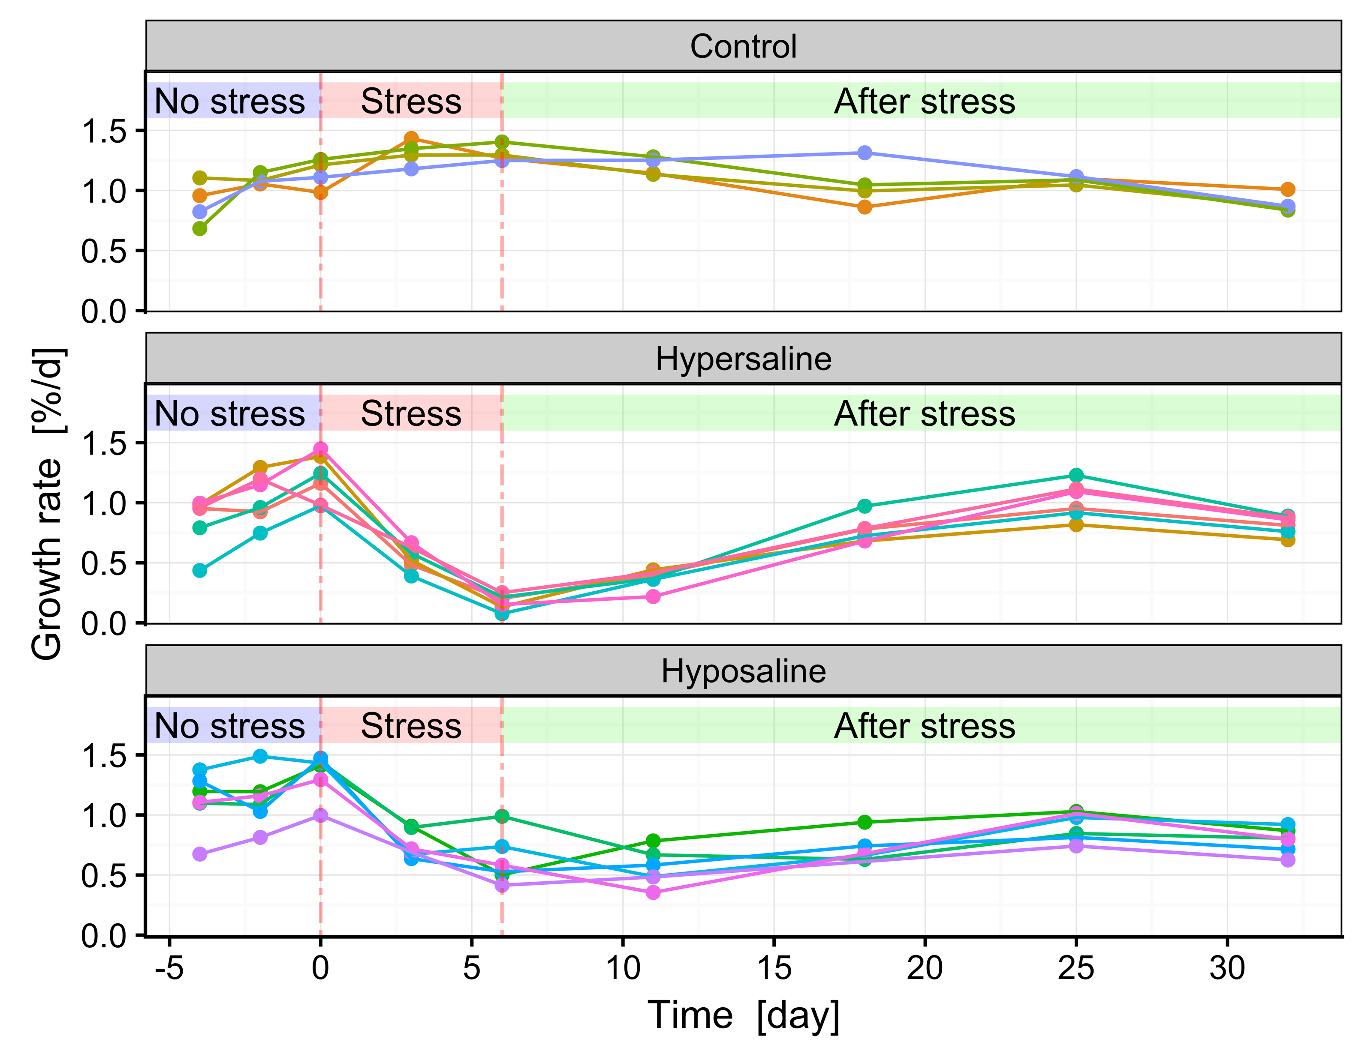
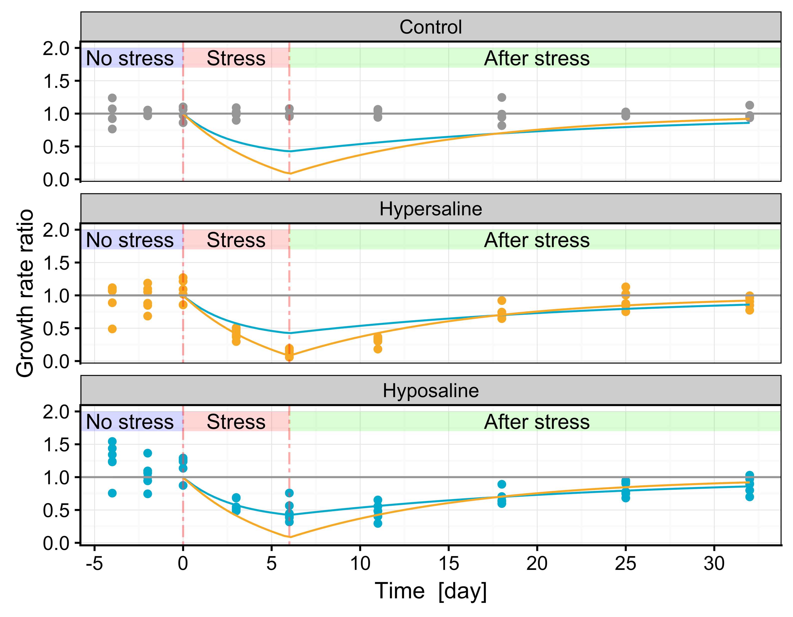
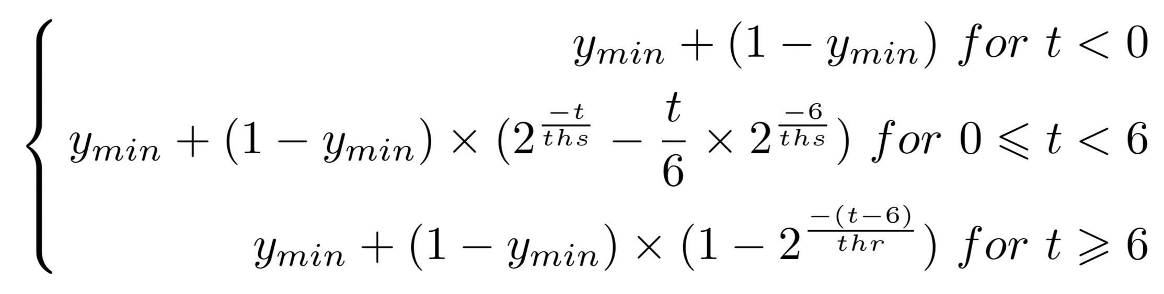
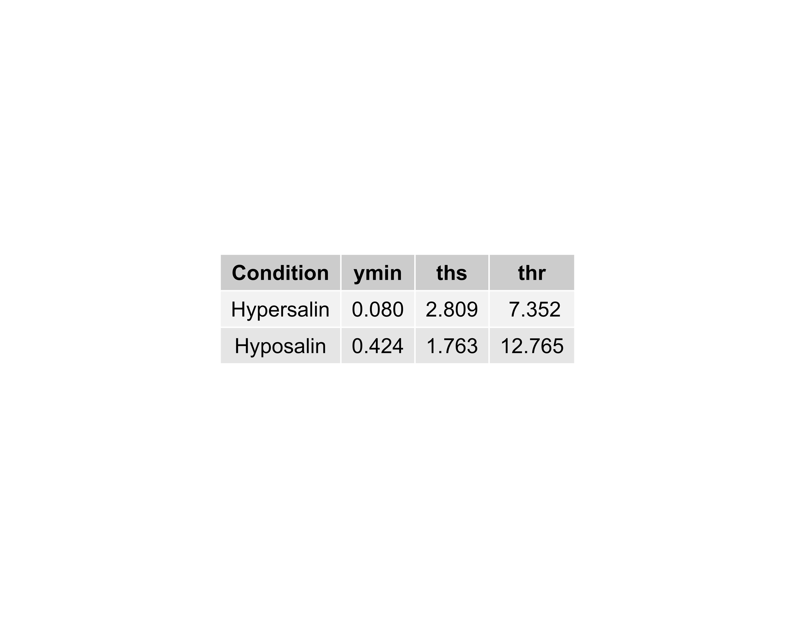
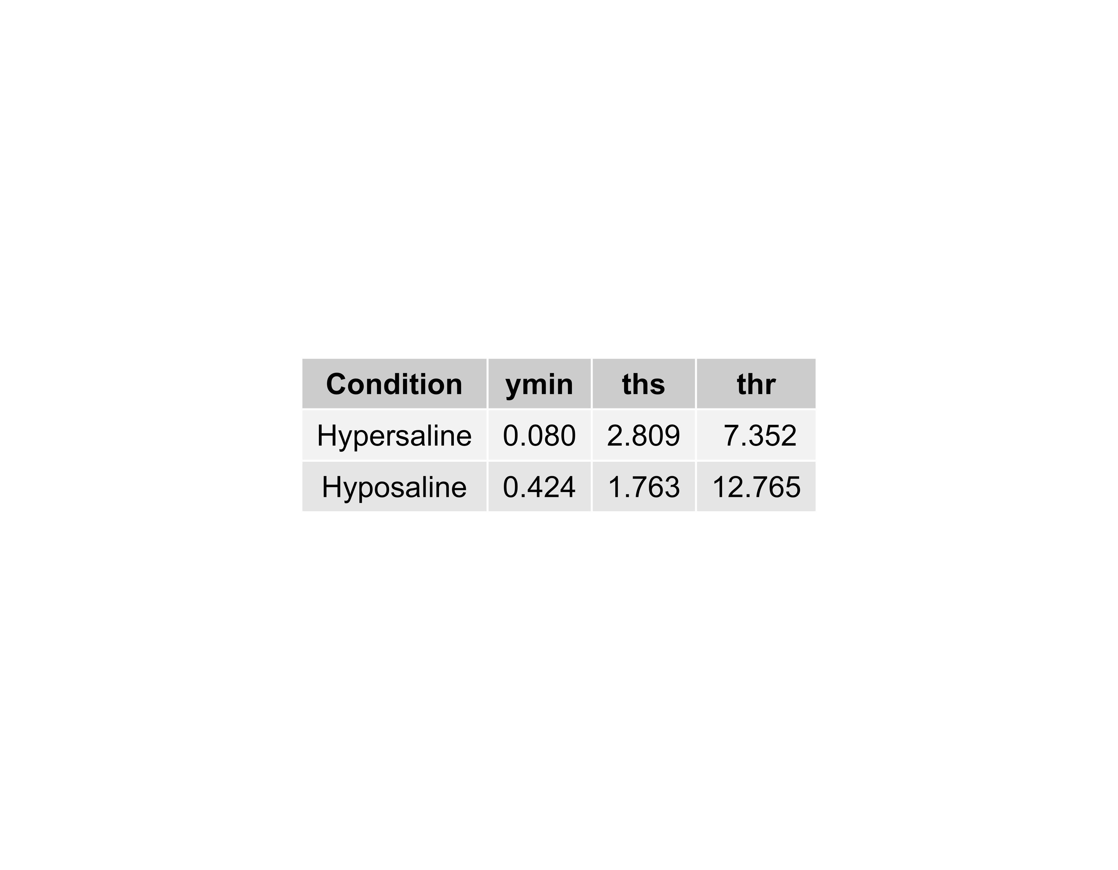
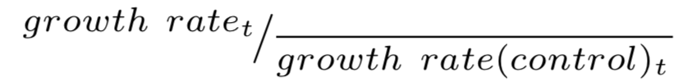
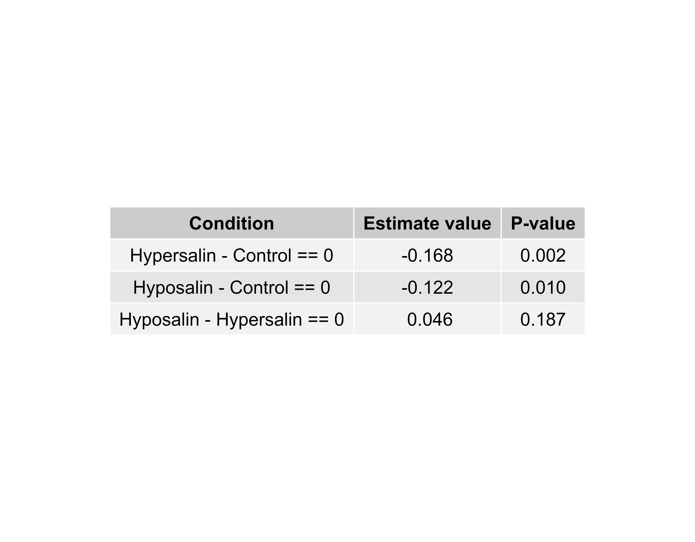
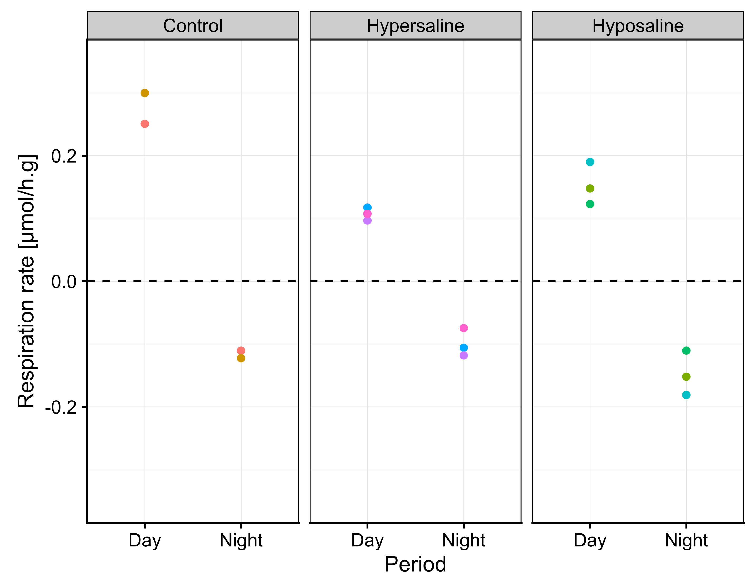
Ecophysiological responses of Seriatopora hystrix (Dana, 1846)
to short-term hypo- and hypersaline stress
G. Engels^{a*} , N. Georgesª , R. Conotteª, A. Batignyª & Ph. Grosjeanª
ª Numerical Ecology of Aquatic systems laboratory, COMPLEXYS and BIOSCIENCES institutes,
University of Mons (UMONS), 6 avenue du champs de mars, 7000 Mons, Belgium
* Corresponding author : guyliann.engels@umons.ac.be - https://github.com/GuyliannEngels
ADD picture
Introduction
Coral reefs are threatened by several stressors. Most of these stressors are directly and indirectly linked to anthropogenic factors such as eutrophication, overfishing, climate change, etc. Salinity is another stressor (Kuanui et al. 2015).
The number of tropical storms has strongly increased over the past decades. These climatic events induce a sharp decrease in salinity a couple of days after their occurrence. Moreover, desalination to produce water for crop irrigation locally increases salinity in the sea.
Material & methods
An artificial coral reef mesocosm (Fig.1) has been used to study the impact of hyposaline (28 PSU) and hypersaline (42 PSU) stresses on Seriatopora hystrix (Dana 1846), a hermatypic scleractinian coral.
Modified conditions were established and maintained for 6 days from an initial value of 35 PSU.
The buoyant weight and the respiration rate in respirometric chambers are measured. The growth rate is calculated from the skeleton weight obtained by the conversion of the buoyant weight (Jokiel et al. 1978) (Fig. 3).
Figure 1: Artificial reef mesocosm to numerical ecology of aquatic systems laboratory (University of Mons)
Results
Figure 2: Growth rate [%/day] over time [days] with three conditions: control (n=4), hypersaline (n=6) and hyposaline (n=6). Three phases are highligthted: no stress, stress and after stress phases.
Corals became paler (but did not bleach) in each stress condition during the stress phases. When the salinity conditions returned to the initial value (35 PSU), the corals recovered their colour.
The growth rate followed the same trend (Fig.2). The growth decreased sharply in each condition during the stress period and then returned to control values (around 1%/day).
Piecewise regressions are used to model the effect on growth rate (Fig.3). The growth rate ratio is not significant before the stress (F(2,13) = 1.793, p-value = 0.205). During the stress phase, the growth rate ratio decreases more in hypersaline than in hyposaline condition. During the recovery phase, the ratio returns to normal faster in hypersaline than in hyposaline condition.
The difference between hyposaline and hypersaline piecewise models is highly significant (F(3,104) = 6.102, p-value < 0.001).
During the stress phase, we have also studied the respiration rate in each condition. No significant difference is measured (F(2,5) = 2.493, p-value = 0.177) at night. However, during the day, the rate is twice as low in the stress conditions. This difference is significant (F(2,5) = 23.388, p-value = 0.003). Multiple comparisons indicate the two stresses is different to control (Tab. 2).
Equation 1: piecewise model on the effect of the growth rate ratio before, during and after stress condition.
Table 1: Parameters of the piecewise models
Figure 3: Growth rate ratio over time [Days] with three conditions control( n=4), hypersaline (n=6) and hyposaline (n=6). Three phases are highligthted: no stress, stress and after stress phases.
The growth rate ratio is
Table 2: Multiple comparisons of means with Tukey contrasts of the respiration rate [µmol/h.g] during the day.
Discussion & conclusion
A change in salinity, even in a short period of time negatively impacts S. hystrix. The nubbin’s colour, the growth rate and the respiration rate have declined in each stress condition.
These results seem to indicate that the zooxanthellae are directly impacted. The hypersaline stress had the strongest effect. Growth rate recovered slowly after the salinity was readjusted to 35 PSU.
Nevertheless, no coral nubbins died, which shows the strong resilience of this species.
-
References
Figure 4: Respiration rate as a function of the three conditions (control( n=2), hypersaline(n=3) and hyposaline (n=3)) and of the day/night periods .
Kuanui, Pataporn & Chavanich, Suchana & Viyakarn, Voranop & Omori, Makoto & Lin, Chiahsin. (2015). Effects of Temperature and Salinity on Survival Rate of Cultured Corals and Photosynthetic Efficiency of Zooxanthellae in Coral Tissues. Ocean Science Journal. 50. 263-268. 10.1007/s12601-015-0023-3
Jokiel, P., Maragos, J., Franzisket, L. (1978). Coral growth: buoyant weight technique. Coral reefs: research methods, UNESCO, Paris, pp.529-541.
For further information, visit: https://github.com/EcoNum/coral_salinity002
Notes:
www.virtualbox.org[
www.ubuntu.com
www.rstudio.com
www.r-project.org
www.github.com
www.lyx.org
www.python.org
www.jupyter.org
pythonhosted.org/spyder/index.htm

